Slide 1

Lecture 8
IGB190
Games Mechanics Implementation
Semester 2, 2024
QUT
Faculty of Science
CRICOS No. 00213J

Slide 2
IGB190 - Weekly Outline
CRICOS No. 00213J
 | Lecture | Workshop | Assessment
Week 1 | Introduction and Overview
Week 2 | Unity & Scripting Basics | Project Setup and Basic Scripting
Week 3 | Principles of Game Mechanics | Avatar Setup & Mechanics
Week 4 | Designing Gameplay Interactions | Enemy Setup & Interactions
Week 5 | Designing Game Mechanics for PX | Assignment 1 – Part B Work
Week 6 | Look, Feel and Flow | Visual Effects, Fine Tuning, UI Elements | A1 Due
Week 7 | RPG Mechanics and Itemisation | A2 Setup, How to Play, Game Balancing
Week 8 | RPG Formulas | Damage Formulas, Recovery and Items
Week 9 | UI and Game Flow / Feedback | Create a Character and Abilities
Mid–Semester Break
Week 10 | Advanced Gameplay Systems | Creating Legendary Items, Enemy Design
Week 11 | Level Design and Layout | Level Design, Encounters, Goals & Quests
Week 12 | Playtesting & Finetuning | Playtesting (lite)
Week 13 |  | Assignment 2 Work and Playtesting Feedback | A2 Due
Note: Topics & order subject to change

Slide 3

Homework(?) – Play an ARPG! (or ARPG-like)
Feedback from students regarding Assignment 2 has been interesting. Some concerns seem to arise from a slight lack of genre familiarity
We do not necessarily want you to change controls, perspective etc, without justification. Junior dev team and design pillars = making a game for fans of the genre
Some free examples to try:
Path of Exile
Lost Ark
Torchlight Infinite
Diablo Immortal…
Will form the focus of an activity for next week!

Slide 4
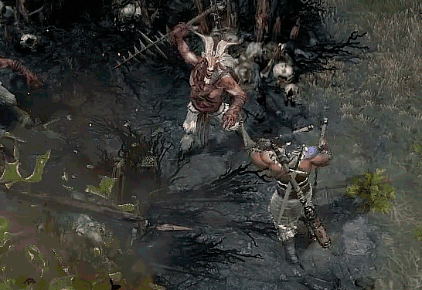
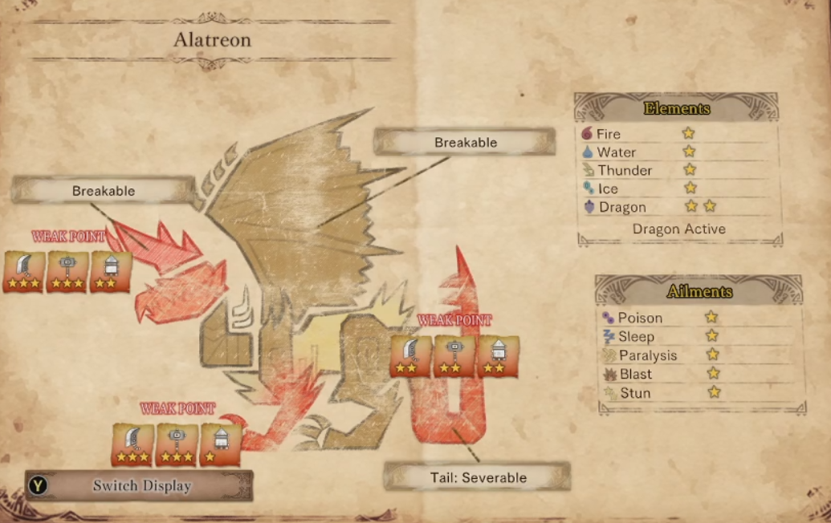
RPG Formulas
Second Part of the RPG discussion, expanding upon RPG Mechanics, Items and Stats
Explore and discuss various RPG mechanics in games and what player choices/options they create
Explore options for designing formulas for our game’s mechanics including ways to add depth
Some of this will be familiar from a IGB120/220 Lecture on RPG Mechanics and Formulas

Slide 5

Player Considerations
Using formulas to adjust simple game systems and mechanics will affect how players play and make choices
Over time, players will also realise there are more optimal ways to play, either individually or as a community
Meta strategies, optimal playstyles and considerations will emerge, sometimes unexpected by developers
Staying ahead of players and understanding the intricacies of your own game systems is important, particularly concerning game balance

Slide 6
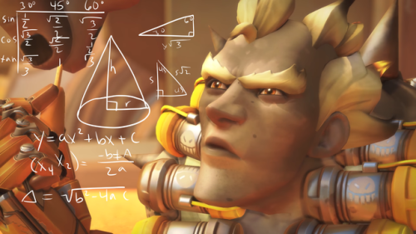
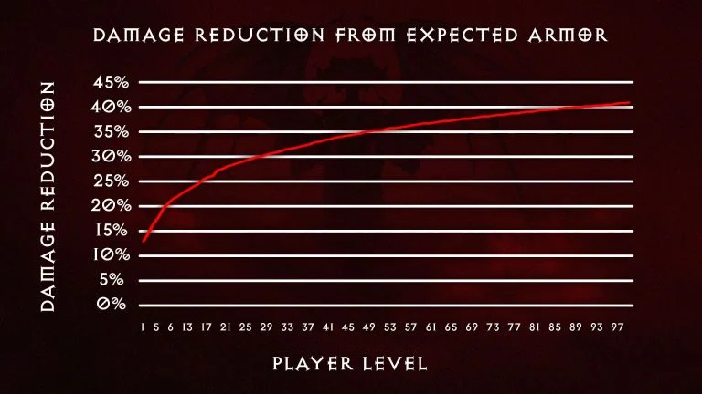
Formulas and Functions
Formulas and functions are the backbone of many mechanics and systems in RPGs (and RPG-like games)
The intricacies of their ‘design’ greatly affect gameplay and therefore the player experience
Some examples:
Experience levelling curve
Damage mitigation
Cooldown reduction diminishing returns
Average damage calculation
Random rolls for gear generation etc
Really, we are talking math, expressions, algebra, physics etc but doing something practical with them: Game Design!

Slide 7
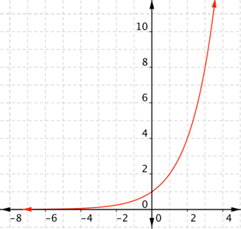
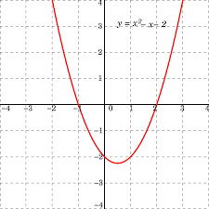
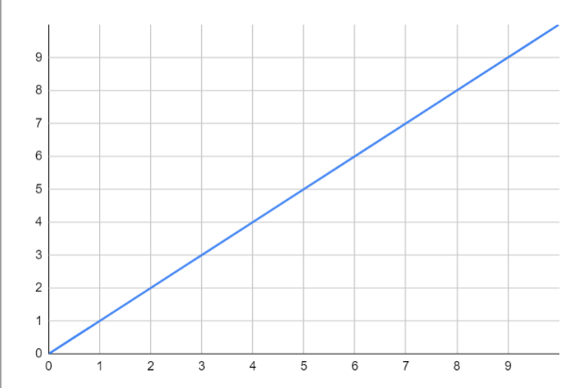
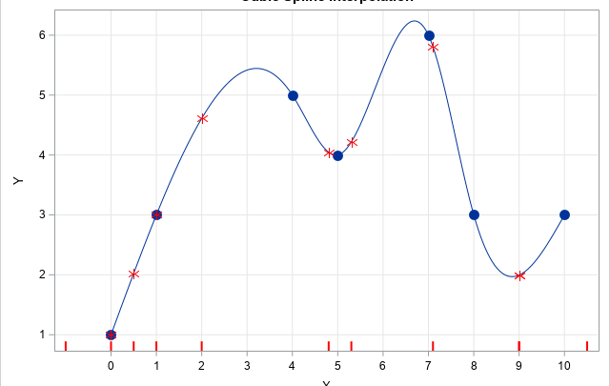
Types of Formulae
Deep, complex and evolving mathematical field
Formula types (basic):
Linear
Exponential
Logarithmic
Sigmoid/Quadratic/Spline etc
Logical/Conditional
Formulas are used to enhance and balance RPG game content!
We will look at elegant examples of these in existing games during this Lecture

Slide 8
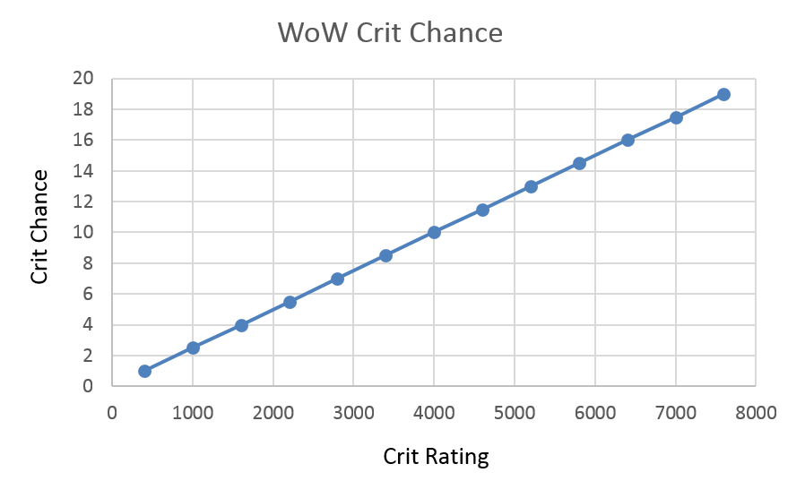
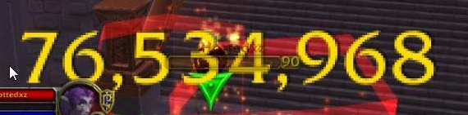
Example: WoW – Critical Strike Chance
WoW uses a value (Crit Rating) to calculate player crit chance. Bonus crit damage is fixed
Varies over expansions, but typically something like 400 CR = 1% Crit Chance
This is a purely linear relationship, no cap or restrictions built in
Limitations of formula based on gear drops. Devs need to balance this distribution carefully, especially at endgame

Slide 9
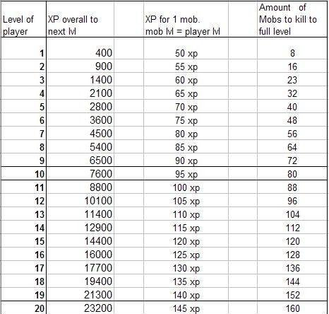
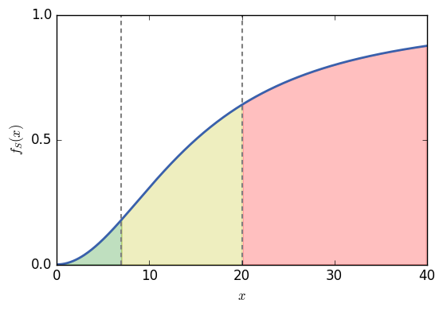
Example: Experience Levelling Curve
From 1-max level, experience gained from questing/mobs should vary
Can scale off mob/quest level vs player level too
Most curves follow something representing an exponential – more xp required per level
However a formula can be tweaked to represent an S shape (sigmoid), or use seperate formula brackets (bezier, spline) to better normalize a levelling experience
Early levels achieved faster
Later levels still slow, but not ridiculously so

Slide 10
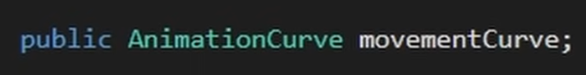
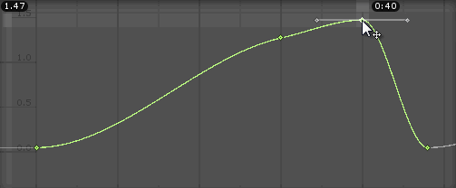
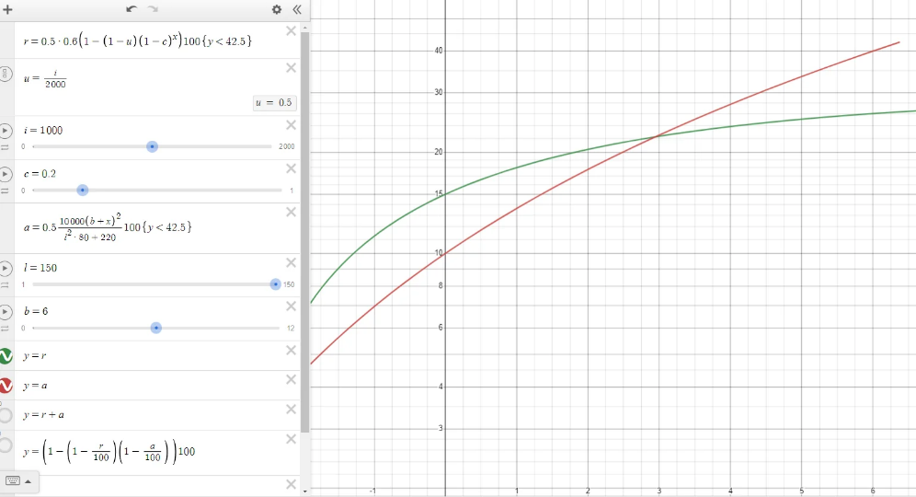
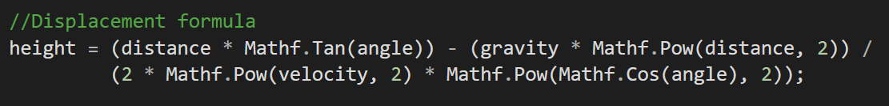
Formula Design - Unity & C#
Unity Animation Curves – Simple spline curves can be used in place of a more complex function. Easy but can lack precision
Online Graphing Tools – desmos.com/calculator
In C# use Mathf Library for access to Sqrt, Pow, Sin/Cos/Tan, Clamp etc (i.e. Mathf.X)

Slide 11

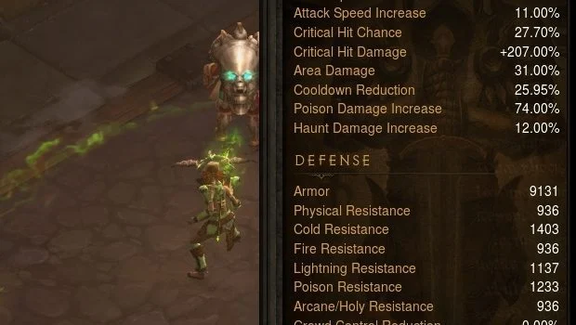
Designing for Decisions
It is often necessary to formulaically design mechanics in a way that inherently encourages good player decision making
Interesting RPG mechanics have the capacity to influence player decision making before and during gameplay (e.g. target priority)
There are endless examples here from all manner of RPG games, virtual and tabletop
Today we will focus on one type of RPG system that is typically ignored by players: Defences

Slide 12

Defences
Defences in RPGs are usually formula driven - used to reduce/mitigate incoming damage to players and NPCs
Defensive stats are typically considered boring by newbie players – they are not flashy, they are passive, rely on being hit etc
However, interesting defensive formulae can shape player options, choices and overall experience playing an RPG
Smart defensive choices typically become the cornerstone of endgame RPG progression

Slide 13

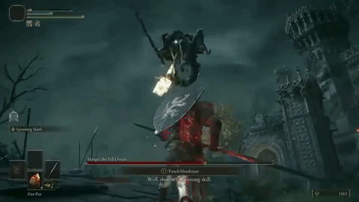
Activity – Defences, Players and Design
Many players can struggle with hard games, higher difficulties or endgame RPG content due to ignoring defences
“Defence mechanics are boring. I just want to do big damage!”
As a game designer, how can you better encourage players to experiment with these rules, mechanics and systems?

Slide 14


Effective Health Points
Increasing your defences increases how much damage you can ‘absorb’
For the purpose of balancing, it is useful to know exactly how tanky you are or can be
Balance between stacking health vs stacking its effective multiplier
A smart player will aim to optimize this. Taking one fifth of incoming damage is the same as having five times as much “effective health”

Slide 15

Effective Health Points
Calculating EHP in games varies, depending on how defences work and what can contribute to it
General Formula:
Health Pool * Defence Contribution = Effective Health Points
Monster Hunter:
Defense EHP = (DEF / 80) + 1
League of Legends:
Armour EHP = Health * (1+ 0.01 * Armor)
Magic EHP = Health * (1+ 0.01 * MR)
Diablo III
Armour EHP = Health x (1 + (Armor/(50 x Monster Level))

Slide 16


Endgame Stats & Itemisation
RPGs should be balanced at lower and higher difficulties around players who will do some minor amount of min-maxing
As designers, it is important to consider formulas for mechanics and how they will scale in the long-term
Both players and enemies should be able to keep up with each other without the numbers on gear and on-screen becoming absurd
Not even big AAA companies do this very well…

Slide 17

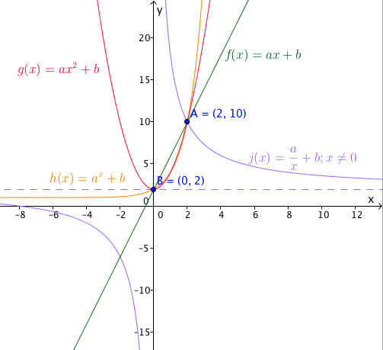
Designing all of this…
Players will break and breakdown your game, so you should be prepared for that. Assignment 2? ☺
As designers, you should create spreadsheets, design formulas, have tables deriving item budgets etc
Such artifacts will vastly improve your capacity to both balance and bug-test aspects of your games
Most importantly, deep discussions amongst your designers, programmers and artists too!
Notes:
https://www.youtube.com/watch?v=uCWJOmGsEqo&t=800s

Slide 18
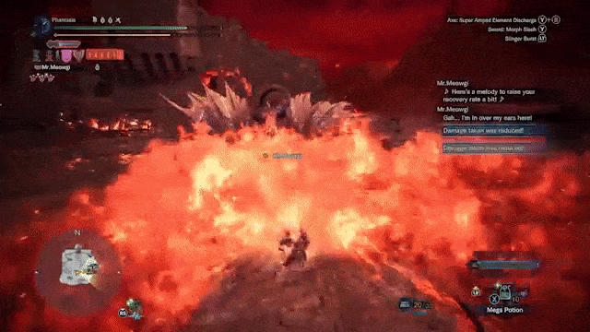

Activity – Other ‘EHP’ related mechanics
Damage mitigation is but one ‘layer’ to consider when attempting to balance items, abilities etc around something like EHP and survivability
Consider what else players have that may contribute to their survivability in typical RPGs
What should be considered when balancing endgame items and encounters?
Notes:
Active dodge, evasion block and parry chances
Active dodge, evasion block and parry mechanics
Relationship with healing and sustain
Overshields and related generation mechanics
Cooldown reduction and ability usage related to all of the above
Diminishing returns

Slide 19
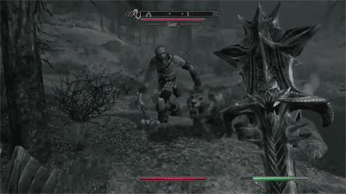
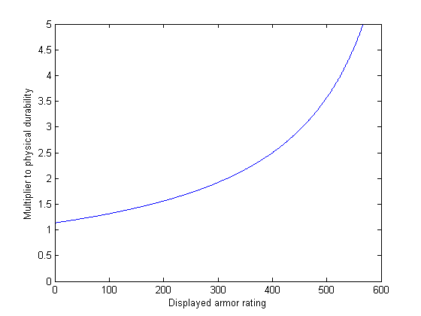
Example: Skyrim - Armour
Each point of Armour Rating reduces physical damage taken by 0.12%
Exponential, until cap at 567 AR (no bonuses)
Maximum of 80% damage reduction (5x)
Formula is linear, but mitigation is exponential
Player considerations:
Stacking and improving armour is worthwhile
Becomes more effective the more you stack!
You don’t need heavy armour, you can improve light armour to the cap with some effort
You are very ‘squishy’ in Skyrim if you ignore armour rating
Mitigation = AR * 0.12

Slide 20
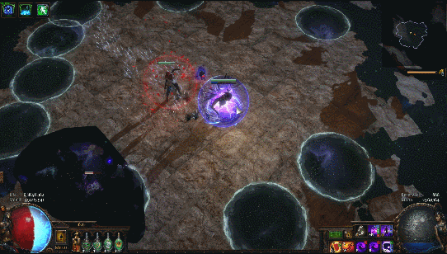
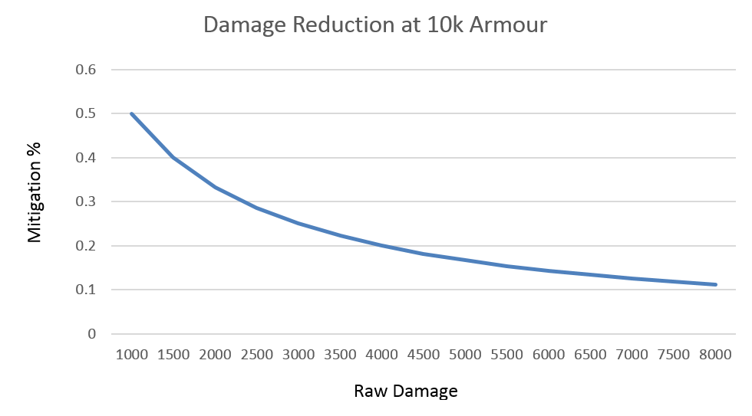
Example: Path of Exile - Armour
Damage Reduction = Armour / (Armour + 10 * Raw Damage)
Path of Exile’s damage mitigation % from armour is a function of how hard you are hit
Player considerations:
Armour rating is situationally dependent
Amazing against lots of weak enemies
Bad against hard hitting enemies (bosses)
Player needs to use other defences to address weaknesses (dodge, evasion, shield etc)
Having multiple layours of defence is meta in PoE

Slide 21

Example: Overwatch - Armour
Armour in Overwatch adds to or replaces health. Mitigation calculation relies on a logical conditional:
if (damage >= 10)
damage -= 5
else
damage /= 2
Player considerations:
Useful at mitigating lots of light attacks (Tracer, Soldier)
Less effective against heavy attacks (Pharah, Widow)
Creates target priority depending on class played
Changes player behaviour of (smart) armour users (Reinhardt)

Slide 22
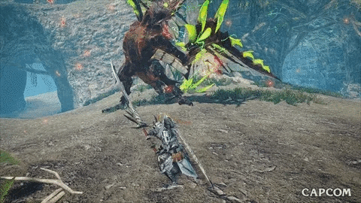
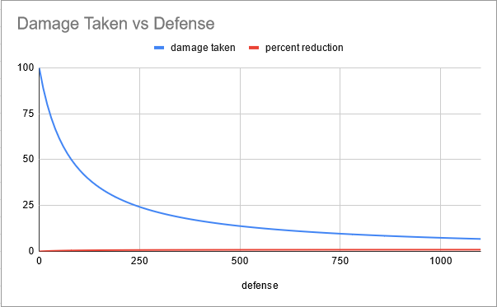
Example: Monster Hunter - Defense
Damage Reduction = 1-(80/80+x)
Where ‘x’ is your defense value
In MH games, your HP typically gets ‘chunked’ by large hits, followed by breathing room. Surviving 2-3 hits in a row is a big deal!
Player considerations:
Try to keep defense relative to monster difficulty
Try not to be one-shottable or be below a % of HP
Determine if increasing tankiness to take 1 more hit is worth it
Try harder to git gud…

Slide 23
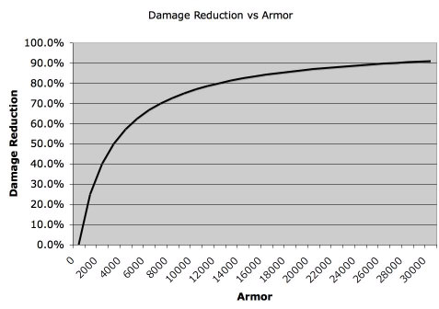
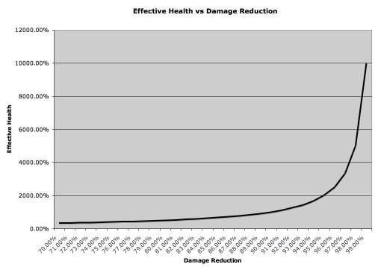
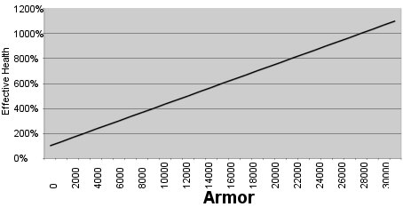
Diminishing Returns
Idea: more points in something (e.g. armor) yields less return than the points before it
Warning: sometimes true, though depends on formulas and content (i.e. % vs tankiness)
More defence will often net you less % dmg reduction as you approach 100%. However, your EHP (vs –dmg%) may become exponential!
Actual relationship between EHP and defense value is usually linear in most games. Defense value is typically capped in the game or hard to get beyond a point etc

Slide 24



The Value of Items
Calculating how much an item is worth, or what its drop chance or stat ranges should also be driven by formulas!
This should be therefore be designer driven. The value of certain stats by players should be calculated
Players will determine this for themselves – broken/cheap items will become the meta
You will do this in Assignment 2 and be evaluated on it

Slide 25
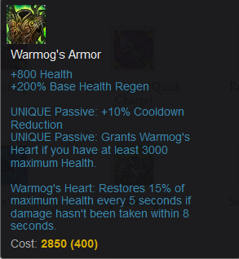
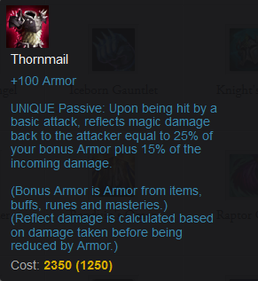
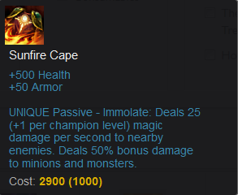
Activity – League Item Value
Hypothetical Situation: 20 min game, your team is losing, their AD carry is fed, has heavy attack damage items, you are the tank/bruiser/top/jungler (i.e. tanky dps)
What item should I buy with my (limited) 2-3k gold to best turn this game around?

Slide 26
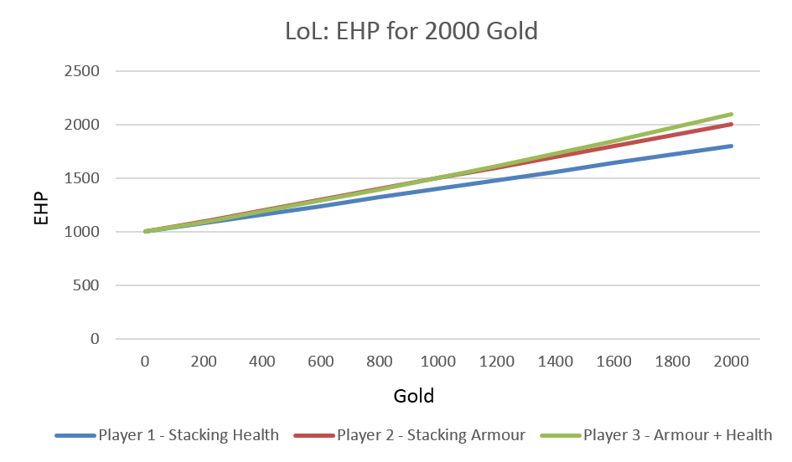
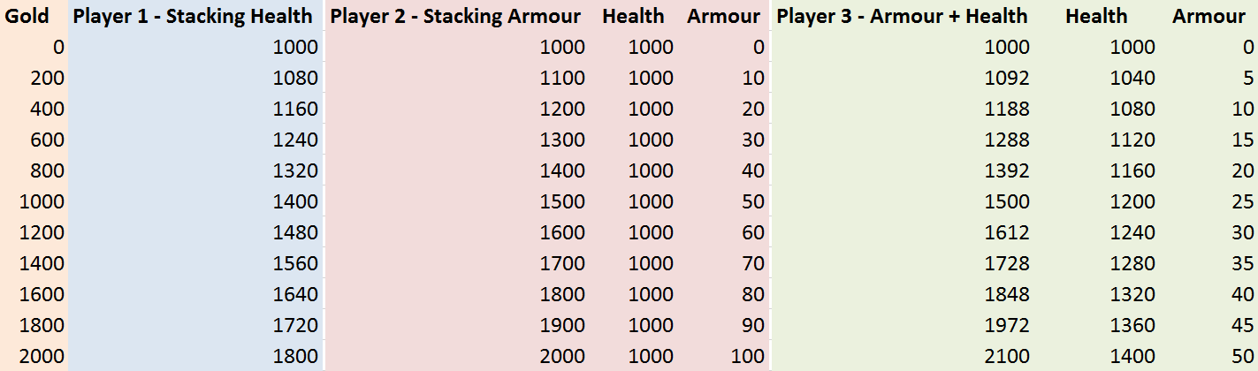
League Item Value
Answer: situationally dependent, but on paper there is a clearer answer
For pure tankiness, stacking just health or just armour is not as effective as stacking both
Buying an item that has both will give you the most EHP
Notice that all items roughly cost the same though…

Slide 27
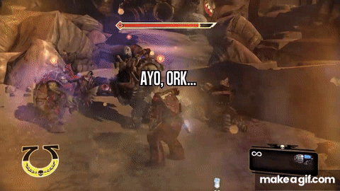
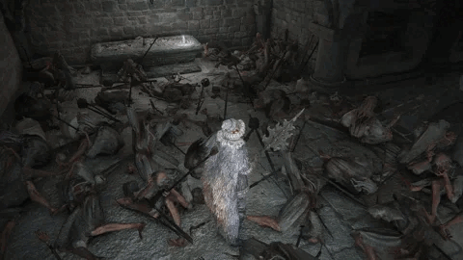
What about offense?
Similar to defence, but mostly turns into world of dmg, crit, crit dmg and maybe attack speed (dps)
This can also become sophisticated, but most (non-RPG) games just opt for simplicity. RPGs will have additional modifiers, hitzones, radius etc
Be careful with how much you provide to players lest it scales out of control!
Players will obviously also aim to optimize and min-max this part of an RPG too

Slide 28
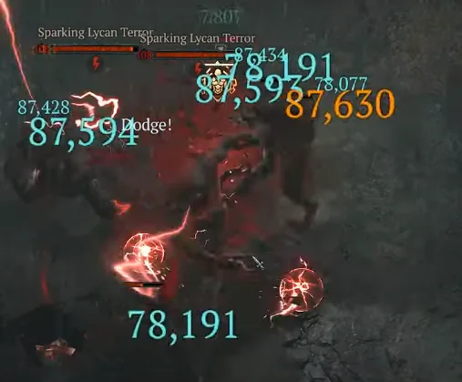
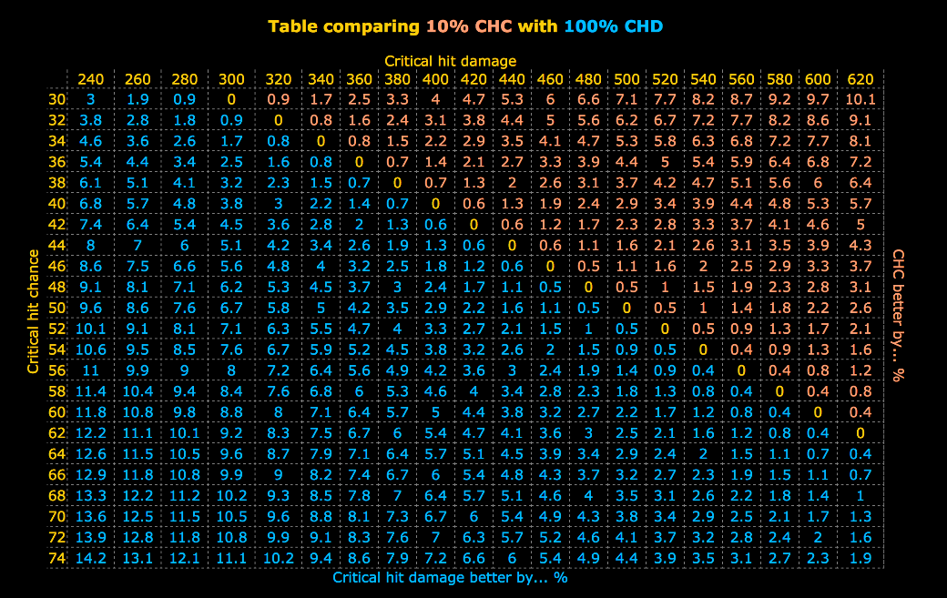
Crit and Crit Damage
Two rules of a damage mechanic that have a direct multiplicative relationship
Example Formula:
Damage = (1-CHC) * dmg + CHC * 100 * (1+CHD)
When comparing something like crit and crit damage, stacking one before the other sometimes makes more sense
Adding attack speed (attacks per second) to this will allow you to calculate DPS!

Slide 29
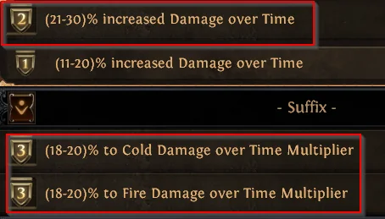
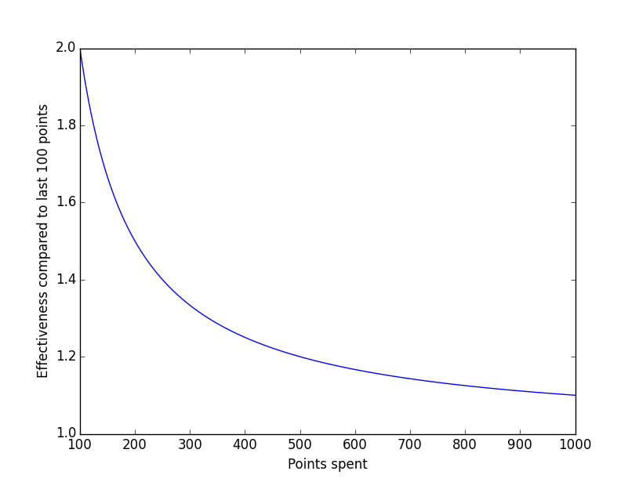
Additive vs Multiplicative
Additive – add stats together, or do so before you multiply it by anything else, e.g:
Damage = 1 * (1 + .2 + .2 + .2) = 1.6
Multiplicative – multiply stats as individual, separate multipliers, e.g:
Damage = 1 * (1+.2) * (1+.2) * (1+.2) = 1.728
Both obviously affected by placement in formula (BOMDAS). Placement will affect outcome drastically (e.g. global modifier, raw flat static increase etc)
Formula design can result in some stats having (actual) diminishing returns

Slide 30
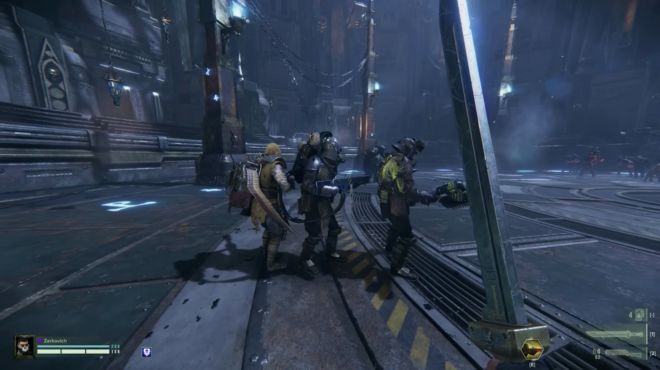
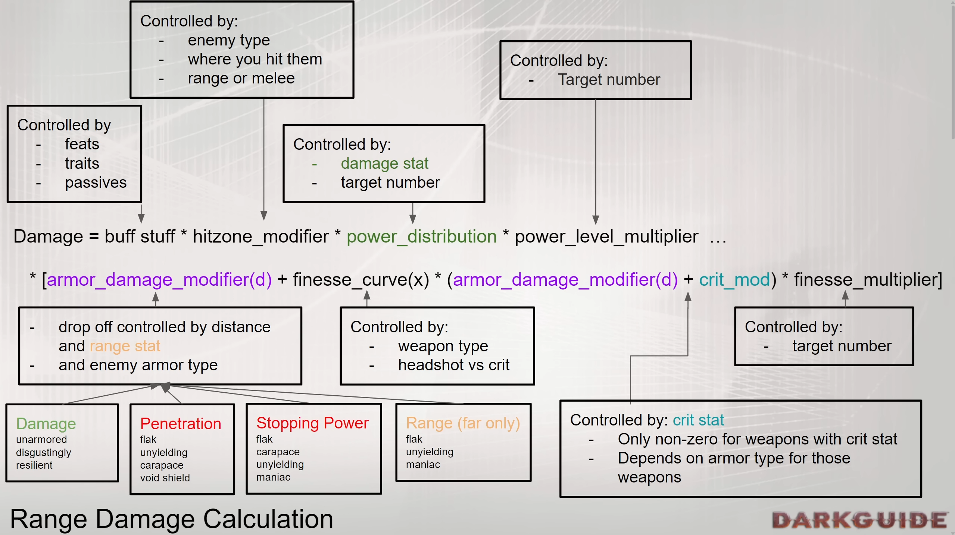
Example: Darktide Damage Calculation
Darktide is an FPS horde shooter with deep and sophisticated ranged and melee options for players
Damage calculation is complex:
Enemies have armor types, hit zones, hit mass properties
Weapons have crit, penetration, cleave, unique multipliers
Cleaving/shooting through targets severely affects your overall damage and distribution
Heavily armoured targets should severely adjust player behaviour when encountered
Notes:
https://www.youtube.com/watch?v=9QlBkFN9RRw&t=1080s

Slide 31
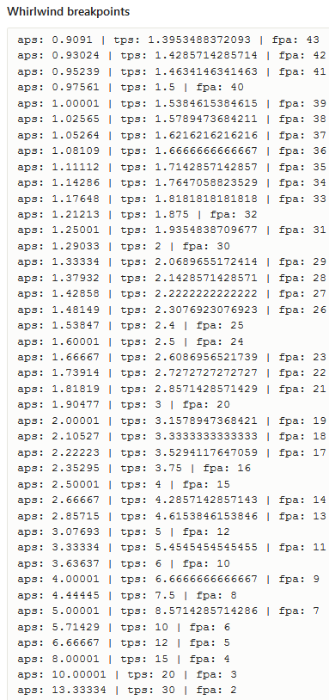

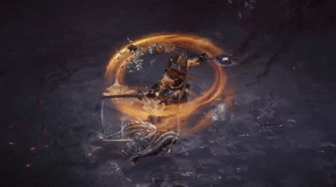
Breakpoints
Many different definitions (context dependent) but typically relates to reaching a value where additions do not make any improvements
Example: Attack Speed Break Point
Stacking more attack speed costs too much and has no real impact on damage output (frame limited)
Break points are often capped by formula design and/or timers (e.g. logarithmic plateau, conditional break, energy regeneration rate)
However some breakpoints are a result of hardware technology (i.e. server framerate)

Slide 32
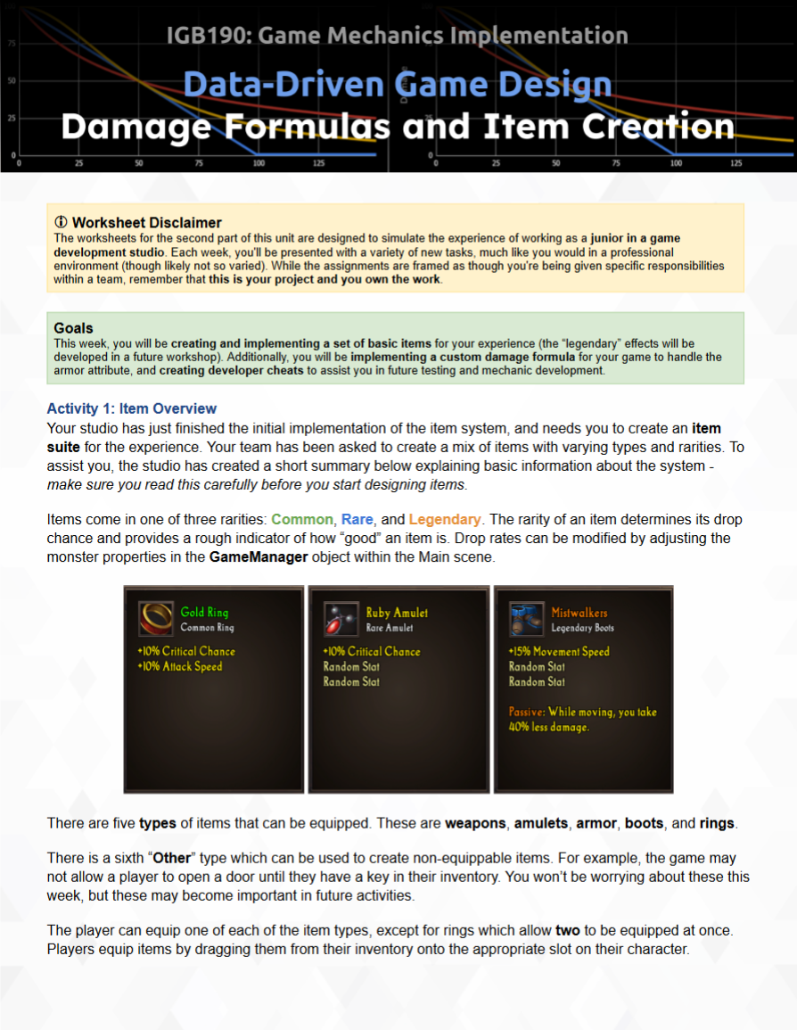
Workshop Content
Item creation, item budgets, armor formulas etc
Additional spreadsheet with calculations for Item Stat Budgeting, Defence Calculations, Critical Strike Damage etc. Feel free to make/add your own too!
Forms justification aspects of your D&J document (A2 - Part B)
You should all be engaging with this content

Slide 33

Any Questions
CRICOS No. 00213J

